Slide 1
NGS Day 3
Adina Howe
adina@iastate.edu
germslab.org
@teeniedeenie

Slide 2
Today’s Schedule
Morning
Mapping and assembly basics lecture
Tutorial – BASH for genomics
Afternoon:
Tutorial – Variant Calling
FUN IN THE SUN!
Evening:
Lecture – Teach me scripting
Student presentations

Slide 3
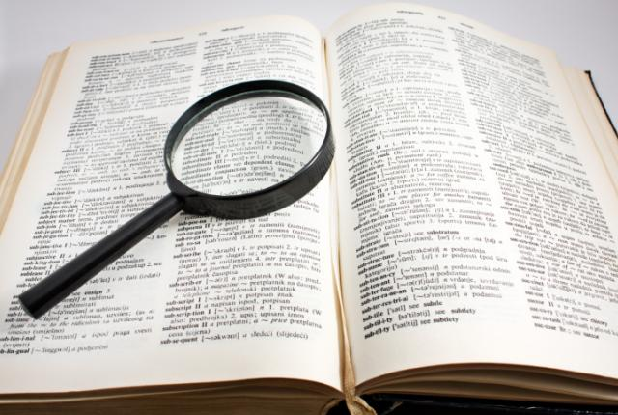
Mapping and assembly

Slide 4
What is mapping?

Slide 5
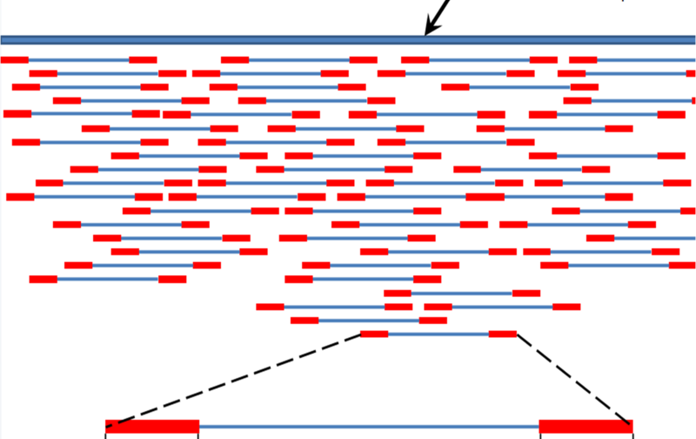
What genes and how many?
http://en.wikipedia.org/wiki/File:Mapping_Reads.png

Slide 6
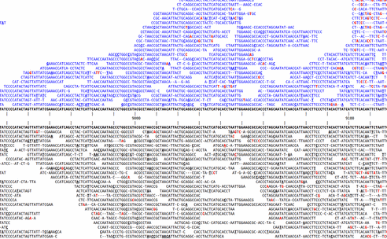
Variations? SNP calling – which variants are “real”
http://www.kenkraaijeveld.nl/genomics/bioinformatics/

Slide 7
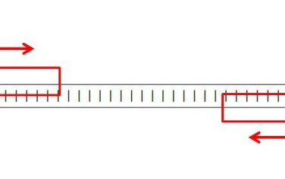
Bonus info with paired end reads
http://www.cureffi.org/2012/12/19/forward-and-reverse-reads-in-paired-end-sequencing/

Slide 8
Note: long v short
Mapping long reads is a different problem from mapping short reads.
This is for two reasons, both of them pragmatic/practical:
  The volume of data has traditionally been much less: 1m 454 reads vs 200m+ Illumina
  Long reads are much more likely to have insertions or deletions in them

Slide 9
How alignment works, and why indels are the devil
There are many alignment strategies, but most work like this:
GCGGAGatggac GCGGAGatggac
||||||...... => ||||||x.....
GCGGAGgcggac GCGGAGgcggac
At each base, try extending alignment; is total score still above threshold?

Slide 10
How alignment works, and why indels are the devil
There are many alignment strategies, but most work like this:
GCGGAGatggac GCGGAGatggac
||||||...... => ||||||xx....
GCGGAGgcggac GCGGAGgcggac
Each mismatch costs.

Slide 11
How alignment works, and why indels are the devil
Insertions/deletions introduce lots more ambiguity:
GCGGAGagaccaacc GCGGAGag-accaacc
|||||| => ||||||
GCGGAGggaaccacc GCGGAGggaacc-acc
GCGGAGagaccaacc GCGGAGaga-ccaacc
|||||| => ||||||
GCGGAGggaaccacc GCGGAGggaacca-cc

Slide 12
Mapping short reads, again
What’s hard about mapping
Some mapping programs
Decisions to be made
Color space issues

Slide 13
Mapping, defined
Exhibit A: 20m+ reads from genome/transcriptome.
Exhibit B: related genome/transcriptome, aka “the reference”
Goal: assign all reads to location(s) within reference.

Slide 14
Want global, not local, alignment
What’s the difference?
  Local = query matches with a portion of reference
  Global = end to end alignment
You do not want matches within the read, like BLAST (basic local alignment search tool) would produce.
Do not use BLAST! Why?

Slide 15
Mapping is “pleasantly parallel”
Goal is to assign each individual read to location(s) within the genome.
So, you can map each read separately.

Slide 16

What makes mapping challenging?
Volume of data
Garbage reads
Errors in reads, and quality scores
Repeat elements and multicopy sequence
SNPs/SNVs
Indels
Splicing (transcriptome)

Slide 17
Volume of data
Size of reference genome is not a problem: you can load essentially any genome into memory (~3 gb).
However, doing any complicated process 20m times is generally going to require optimization!

Slide 18
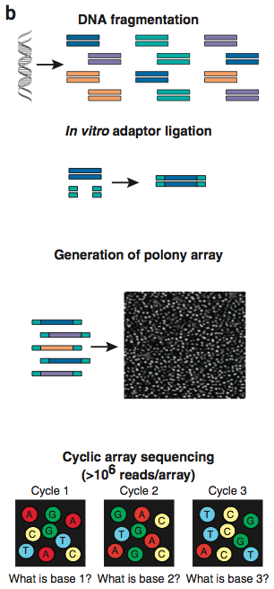
Garbage reads
Overlapping polonies result in mixed signals.
These reads will not map to anything!
Used to be ~40% of data.
Increasingly, filtered out by sequencing software.
Shendure and Ji, Nat Biotech, 2008

Slide 19
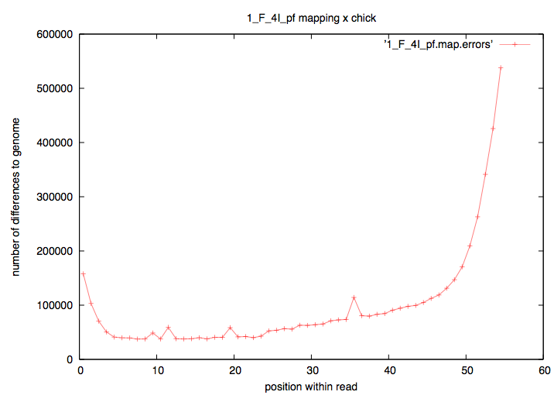
Errors in reads
When mapping, a mismatch is not necessarily “real”.
Rule of thumb: anything that varies by position within read is NOT REAL!

Slide 20
Errors in reads
Quality scores are based on Sanger sequencing-style quality scores: per base.
But 454 & Ion/Proton data are subject to different biases than Illumina, and the biases are not necessarily base-by-base (think: homopolymer runs)

Slide 21
Repeat/multi-copy elements
Multi-copy sequence makes it impossible to map all reads uniquely.
Repeats are particularly bad, because there are (a) lots of them and (b) they vary in sequence. They therefore may “attract” reads depending on what optimizations/heuristics you use.

Slide 22
SNP/SNVs
Genuine mismatches between reference and sequence do exist, of course.
  Polymorphism
  Diploidy
  Population studies
You want to map these reads!
Fast heuristic approaches exist, based on fuzzy matching.
However, they are still biased towards mapping exact matches.
  This can be a problem for allelotyping and population studies.

Slide 23
Indels
Remember, they are the devil:
Complicate mapping heuristics
Complicate statistics

Slide 24
Indels: ambiguity & decisions…
TGACGATATGGCGATGGACTGGACG
|x|||||||||||x||x|x||||||
TcACGATATGGCGgTGaA-TGGACG
TGACGATATGGCGATGGACTGGACG
|x|||||||||||x|x||x||||||
TcACGATATGGCGgT-GAaTGGACG

Slide 25
Splice sites
If you are mapping transcriptome reads to the genome, your reference sequence is different from your source sequence!
This is a problem if you don’t have a really good annotation!

Slide 26
Two specific mapping programs
Bowtie
  Bowtie v1: Can’t map across indels; great for exact matching
  Bowtie v2: Much slower but is more flexible
BWA
Both open source.
BWA is widely used now, so we’ll use that for examples.
(There are many more, too.)

Slide 27

Tools for mapping reads

Slide 28
Things to think about
Indel capable
Memory efficient
Good documentation
Maintained

Slide 29
Bowtie1
Not indel-capable. Fixed with Bowtie2 (Adina approved)
Designed for:
  Many reads have one good, valid alignment
  Many reads are high quality
  Small number of alignments/read
  a.k.a. “sweet spot” :)

Slide 30
BWA
Uses similar strategy to Bowtie, but does gapped alignment.
Newest, hottest tool.
Written by the Mapping God, Heng Li
(Istvan Albert’s scientific crush)

Slide 31
Decisions to be made by you
How many mismatches to allow?
  Vary depending on biology & completeness of reference genome
Report how many matches?
  Are you interested in multiple matches?
Require best match, or first/any that fit criteria?
  It can be much faster to find first match that fits your criteria.
  All of these decisions affect your results and how you treat your data.

Slide 32
Mapping best done on entire reference
May be tempted to optimize by doing mapping to one chr, etc. “just to see what happens”
Don’t.
Simple reason: if you allow mismatches, then many of your reads will match erroneously to what’s in the chr you chose.

Slide 33
Look at your mapping
Just like statistics, always look at your “raw data” ☺
We’ll do some of that today.

Slide 34
First step to mapping: indexing your reference
Building an index
  Prepares your “reference”
  (Not really a big deal for single microbial genomes)

Slide 35
Indexing – e.g. BLAST
BLASTN filters sequences for exact matches between “words” of length 11:
GAGGGTATGACGATATGGCGATGGAC
||x|||||x|||||||||||x|x||x
GAcGGTATcACGATATGGCGgT-Gag
What the ‘formatdb’ command does (see Tuesday’s first tutorial) is build an index (“index”) sequences by their 11-base word content – a “reverse index” of sorts.

Slide 36
Indexing – e.g. BLAST
What the ‘formatdb’ command does (see Tuesday’s BLAST tutorial) is build an index (“index”) sequences by their 11-base word content – a “reverse index” of sorts.
Since this index only needs to be built once for each reference, it can be slower to build – what matters to most people is mapping speed.
All short-read mappers have an indexing step.

Slide 37
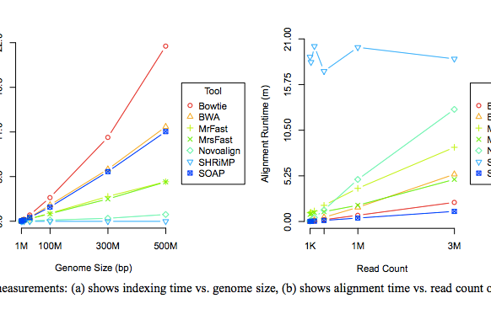
Speed of indexing & mapping.
Fig 5 of Ruffalo et al. PMID 21856737, Bioinformatics 2011.

Slide 38
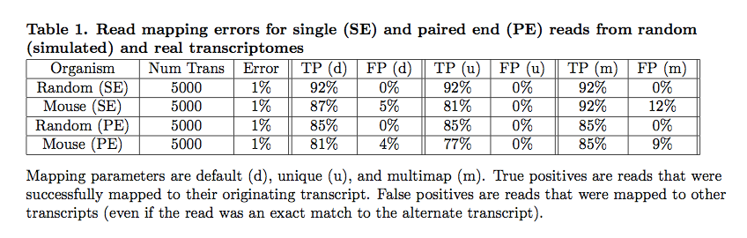
Simulations => understanding mappers
Mappers will ignore some fraction of reads due to errors.
Pyrkosz et al., unpub.; http://arxiv.org/abs/1303.2411

Slide 39
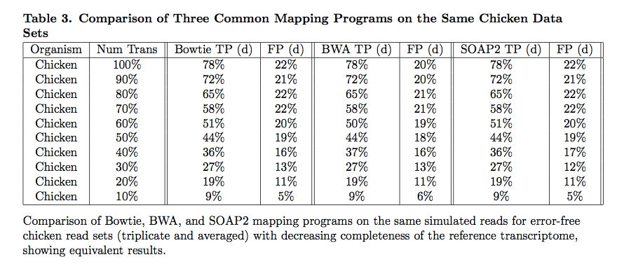
Does choice of mapper matter?
Not in our experience.
Reference completeness/quality matters more!
Pyrkosz et al., unpub.; http://arxiv.org/abs/1303.2411

Slide 40
It depends….What is your question?
Transcriptomes and bacterial genomes have very few repeats…
…but for transcriptomes, you need to think about shared exons.
For genotyping/association studies/ASE, you may not care about indels too much.

Slide 41
Part II:
De novo Assembly

Slide 42
Assembly vs mapping
No reference needed, for assembly!
  De novo genomes, transcriptomes…
But:
  Scales poorly; need a much bigger computer.
  Biology gets in the way (repeats!)
  Need higher coverage
But but:
  Often your reference isn’t that great, so assembly may actually be the best way to go.

Slide 43
Assembly
It was the best of times, it was the wor
, it was the worst of times, it was the
isdom, it was the age of foolishness
mes, it was the age of wisdom, it was th
It was the best of times, it was the worst of times, it was the age of wisdom, it was the age of foolishness
…but for lots and lots of fragments!

Slide 44
Assemble based on word overlaps:
the quick brown fox jumped
jumped over the lazy dog
the quick brown fox jumped over the lazy dog
Repeats do cause problems:
my chemical romance: na na na
na na na, batman!

Slide 45
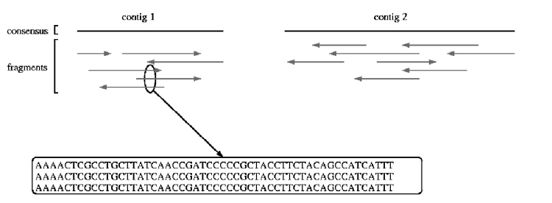
Shotgun sequencing & assembly
Randomly fragment & sequence from DNA;
reassemble computationally.
UMD assembly primer (cbcb.umd.edu)

Slide 46
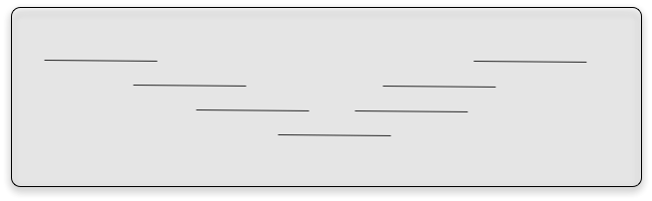
Assembly – no subdivision!
Assembly is inherently an all by all process. There is no good way to subdivide the reads without potentially missing a key connection

Slide 47
Short-read assembly
Short-read assembly is problematic
Relies on very deep coverage, ruthless read trimming, paired ends.
UMD assembly primer (cbcb.umd.edu)

Slide 48
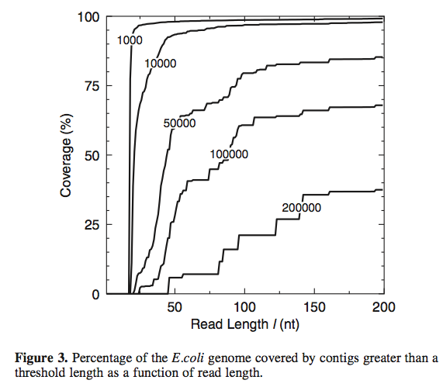
Short read lengths are hard.
Whiteford et al., Nuc. Acid Res, 2005

Slide 49
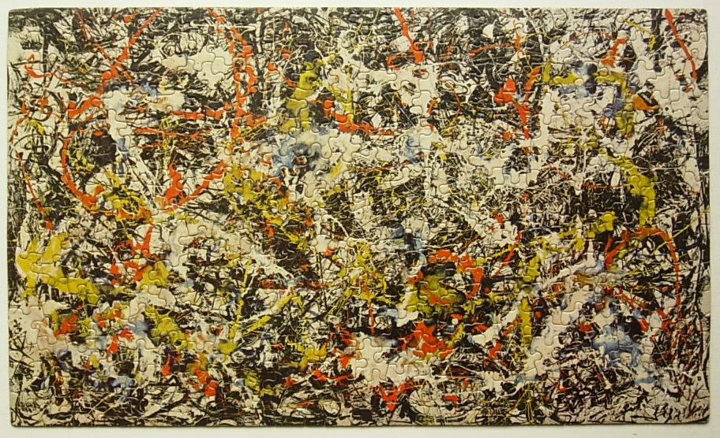
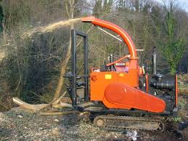
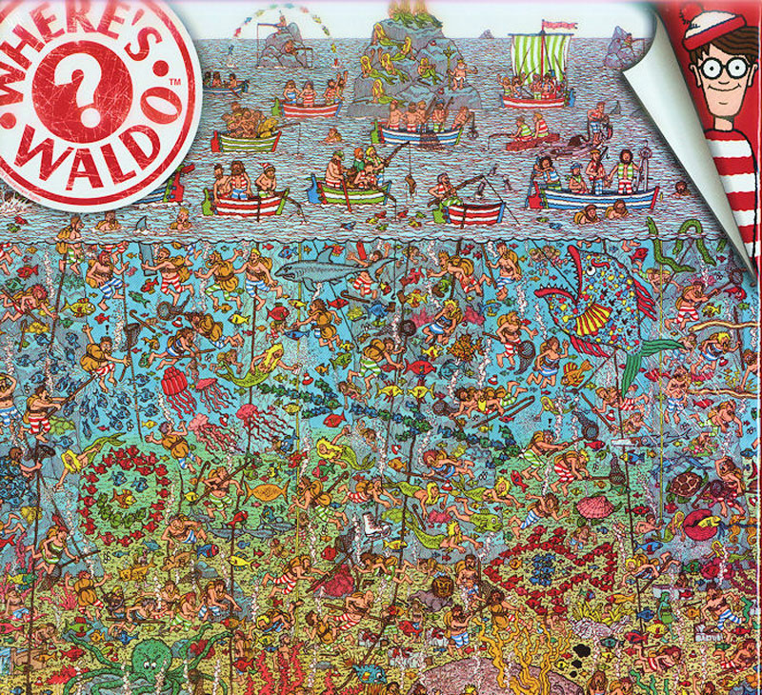

Challenges to Assembly
Variation
Sampling
Mistakes
No reference
Notes:
Convergence, jackson pollock - repeats
Introduce metagenomics sequencing with woodchipper
Introduce coverage and sampling
Introduce choices for analysis – demonstrate blast
Introduce assembly
Introduce coverage of soil

Slide 50
Four main challenges for de novo sequencing.
Repeats.
Low coverage.
Errors
These introduce breaks in the
construction of contigs.
Variation in coverage – transcriptomes and metagenomes, as well as amplified genomic.
This challenges the assembler to distinguish between erroneous connections (e.g. repeats) and real connections.

Slide 51
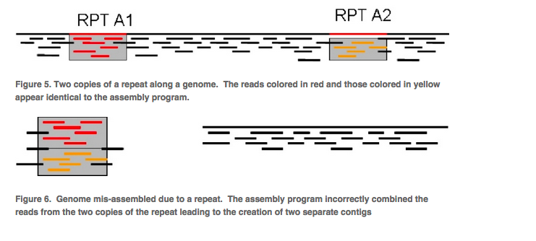
Repeats
Overlaps don’t place sequences uniquely when there are repeats present.
UMD assembly primer (cbcb.umd.edu)

Slide 52
Coverage
Easy calculation:
(# reads x avg read length) / genome size

Slide 53
Coverage
“1x” doesn’t mean every DNA sequence is read once.
It means that, if sampling were systematic, it would be.
Sampling isn’t systematic, it’s random!

Slide 54
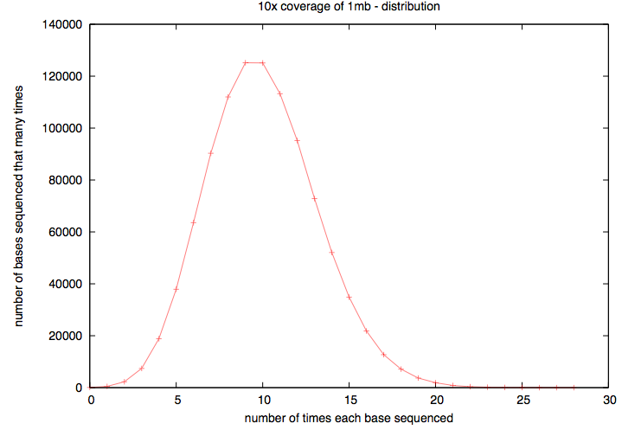
Actual coverage varies widely from the average, for low avg coverage
Notes:
High coverage is essential.

Slide 55
Two basic assembly approaches
Overlap/layout/consensus
De Bruijn k-mer graphs
The former is used for long reads, esp all Sanger-based assemblies. The latter is used because of memory efficiency.

Slide 56
Overlap/layout/consensus
Essentially,
Calculate all overlaps
Cluster based on overlap.
Do a multiple sequence alignment
UMD assembly primer (cbcb.umd.edu)

Slide 57
K-mers
Break reads (of any length) down into multiple overlapping words of fixed length k.
ATGGACCAGATGACAC (k=12) =>
ATGGACCAGATG
TGGACCAGATGA
GGACCAGATGAC
GACCAGATGACA
ACCAGATGACAC
Notes:
Note, no tolerance for indels

Slide 58
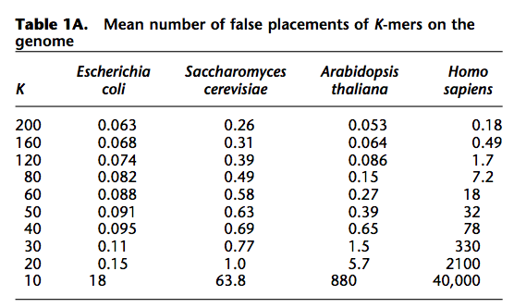
K-mers – what k to use?
Butler et al., Genome Res, 2009

Slide 59
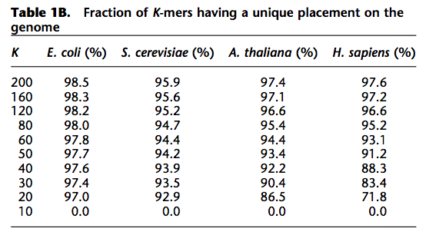
K-mers – what k to use?
Butler et al., Genome Res, 2009

Slide 60
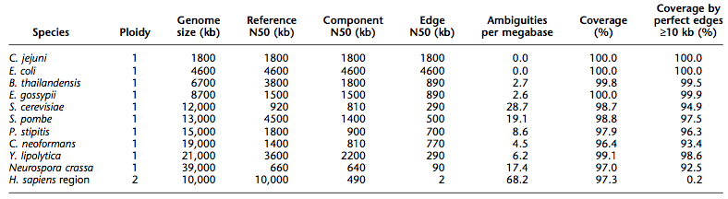
Big genomes are problematic
Butler et al., Genome Res, 2009

Slide 61
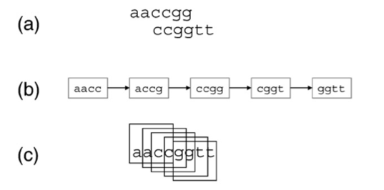
K-mer graphs - overlaps
J.R. Miller et al. / Genomics (2010)

Slide 62
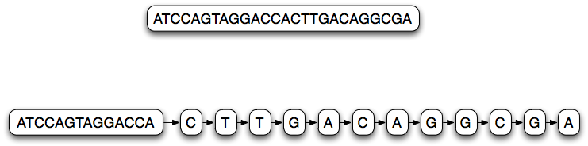
K-mer graph (k=14)
Each node represents a 14-mer;
Links between each node are 13-mer overlaps

Slide 63
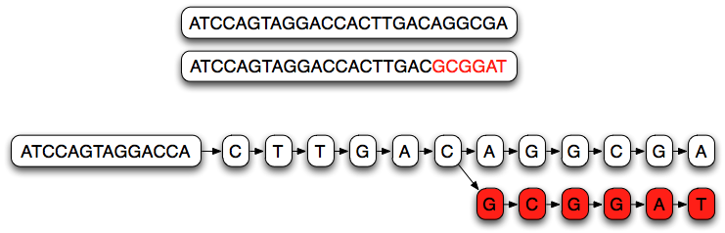
K-mer graph (k=14)
Branches in the graph represent partially overlapping sequences.

Slide 64
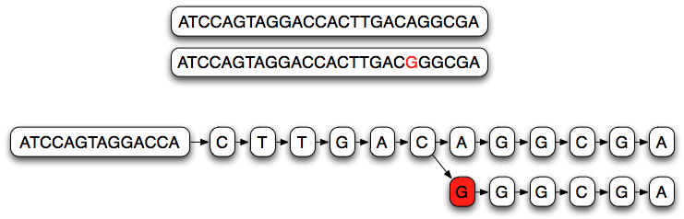
K-mer graph (k=14)
Single nucleotide variations cause long branches

Slide 65
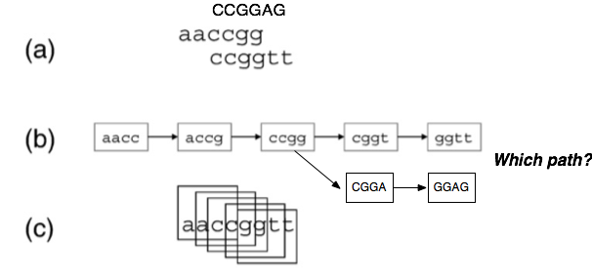
K-mer graphs - branching
For decisions about which paths etc, biology-based heuristics come into play as well.

Slide 66
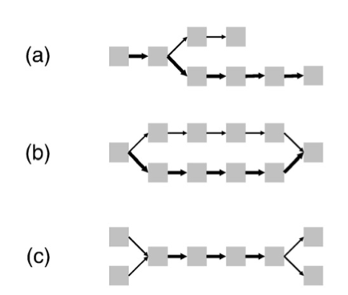
K-mer graph complexity - spur
(Short) dead-end in graph.
Can be caused by error at the end of some overlapping reads, or low coverage
J.R. Miller et al. / Genomics (2010)

Slide 67
K-mer graph complexity - bubble
Multiple parallel paths that diverge and join.
Caused by sequencing error and true polymorphism / polyploidy in sample.
J.R. Miller et al. / Genomics (2010)

Slide 68
K-mer graph complexity – “frayed rope”
Converging, then diverging paths.
Caused by repetitive sequences.
J.R. Miller et al. / Genomics (2010)

Slide 69
Resolving graph complexity
Primarily heuristic (approximate) approaches.
Detecting complex graph structures can generally not be done efficiently.
Much of the divergence in functionality of new assemblers comes from this.
Three examples:

Slide 70
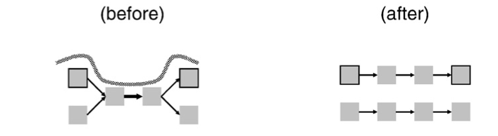
Read threading
Single read spans k-mer graph => extract the single-read path.
J.R. Miller et al. / Genomics (2010)

Slide 71
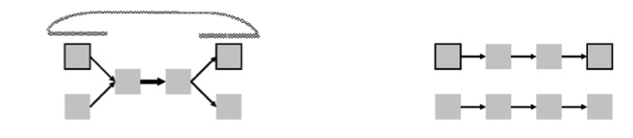
Mate threading
Resolve “frayed-rope” pattern caused by repeats, by separating paths based on mate-pair reads.
J.R. Miller et al. / Genomics (2010)

Slide 72
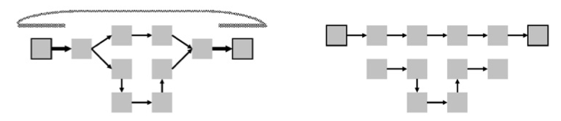
Path following
Reject inconsistent paths based on mate-pair reads and insert size.
J.R. Miller et al. / Genomics (2010)

Slide 73
More assembly issues
Many parameters to optimize!
RNAseq has variation in copy number; naïve assemblers can treat this as repetitive and eliminate it.
Some assemblers require gobs of memory (4 lanes, 60m reads => ~ 150gb RAM)
How do we evaluate assemblies?
  What’s the best assembler?

Slide 74
K-mer based assemblers scale poorly
Why do big data sets require big machines??
Memory usage ~ “real” variation + number of errors
Number of errors ~ size of data set

Slide 75
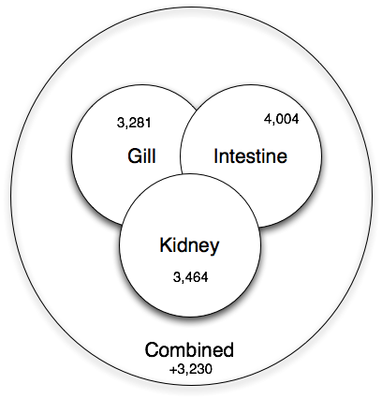
Co-assembly is important for sensitivity
Shared low-level transcripts may not reach the threshold for assembly.

Slide 76
Is your assembly good?
For genomes, N50 is an OK measure:
  “50% or more of the genome is in contigs > this number”
That assumes your contigs are correct…!
What about mRNA and metagenomes??
Truly reference-free assembly is hard to evaluate.

Slide 77
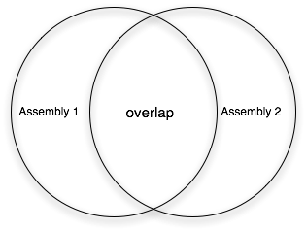
How do you compare assemblies?

Slide 78
What’s the best assembler?
Bradnam et al., Assemblathon 2:
http://arxiv.org/pdf/1301.5406v1.pdf

Slide 79
What’s the best assembler?
Bradnam et al., Assemblathon 2:
http://arxiv.org/pdf/1301.5406v1.pdf

Slide 80
What’s the best assembler?
Bradnam et al., Assemblathon 2:
http://arxiv.org/pdf/1301.5406v1.pdf

Slide 81
Note: the teams mostly used multiple software packages

Slide 82
Answer: it depends
Different assemblers perform differently, depending on
  Repeat content
  Heterozygosity
Generally the results are very good (est completeness, etc.) but different between different assemblers (!)
There Is No One Answer.

Slide 83
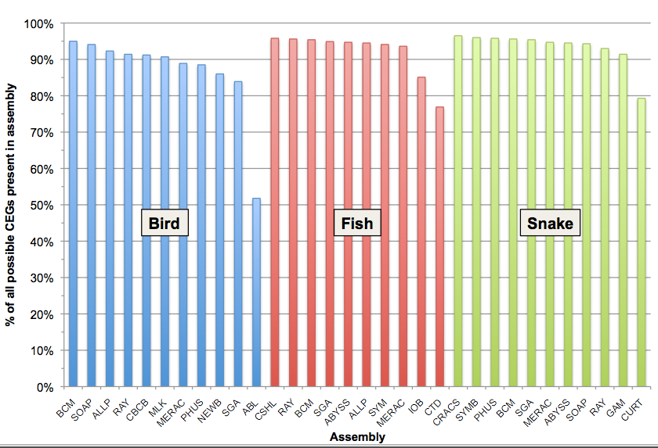
Estimated completeness: CEGMA
Each assembler lost different ~5% CEGs

Slide 84
Practical issues
Do you have enough memory?
Trim vs use quality scores?
When is your assembly as good as it gets?
Paired-end vs longer reads?
More data is not necessarily better, if it introduces more errors.

Slide 85
Practical issues
Many bacterial genomes can be completely assembled with a combination of PacBio and Illumina.
As soon as repeats, heterozygosity, and GC variation enter the picture, all bets are off (eukaryotes are trouble!)

Slide 86
Mapping & assembly
Assembly and mapping (and variations thereof) are the two basic approaches used to deal with next-gen sequencing data.
Go forth! Map! Assemble!

